Slide 1
DB2 Universal Database
DB2 Training class 01

Slide 2
Database Structures
Network Structures (e.g. IDMS)
Many to Many relationships
Complex structure using Pointers
Best for Keeping storage
Hierarchical Structures (e.g. IMS DB)
One to Many Relationships
Inverted Tree like Structure
Best for storing parent and child type entities
Relational Structures (e.g. DB2)
One to Many, Many to One
Best for ease of data retrieval

Slide 3
Data and Database
Data : Collection of facts suitable for communications
A Database is a collection of interrelated data items, stored once and organized in a form for easy retrieval.
A Database Management System is a collection of programs for storing organizing, selecting, modifying, and extracting data from a database.
Table is a collection of related data entries and it consists of columns and rows.

Slide 4
Introduction to DB2
DB2, formally called DATABASE 2, was born on MVS in 1983. In 1987, DB2 arrived on the Personal Computer
Along the way the name changed from DB2 to DB2 for Common Servers and then became DB2 Universal Database.
DB2 9 is the latest release of IBM's popular data management software for distributed systems
DB2 runs on a wide variety of platforms (AIX, HP-UX, Linux, Solaris, Windows, i5/OS, and z/OS), and several editions are available-each of which has been designed to meet a specific business need collectively know as DB2 Family

Slide 5
File Vs Databases
Data more redundant
Duplicate data
Data insecure
No control over data
Threat to Integrity
Lack of inbuilt recovery features
Lack of data Locks
Redundancy avoided
Minimize Duplicates
Security provided
Field level sensitivity
Consistency of data
Data Logging, Commits & Rollbacks
Automatic locks

Slide 6
DB2 Objects
DB2 consists two different type of objects
  System Objects : objects that are controlled and used by DB2.
      DB2 Catalog
      DB2 directory
      Active Log
      Boot strap dataset
      Buffer pools
  Data Objects : objects that are created and used by the users.

Slide 7
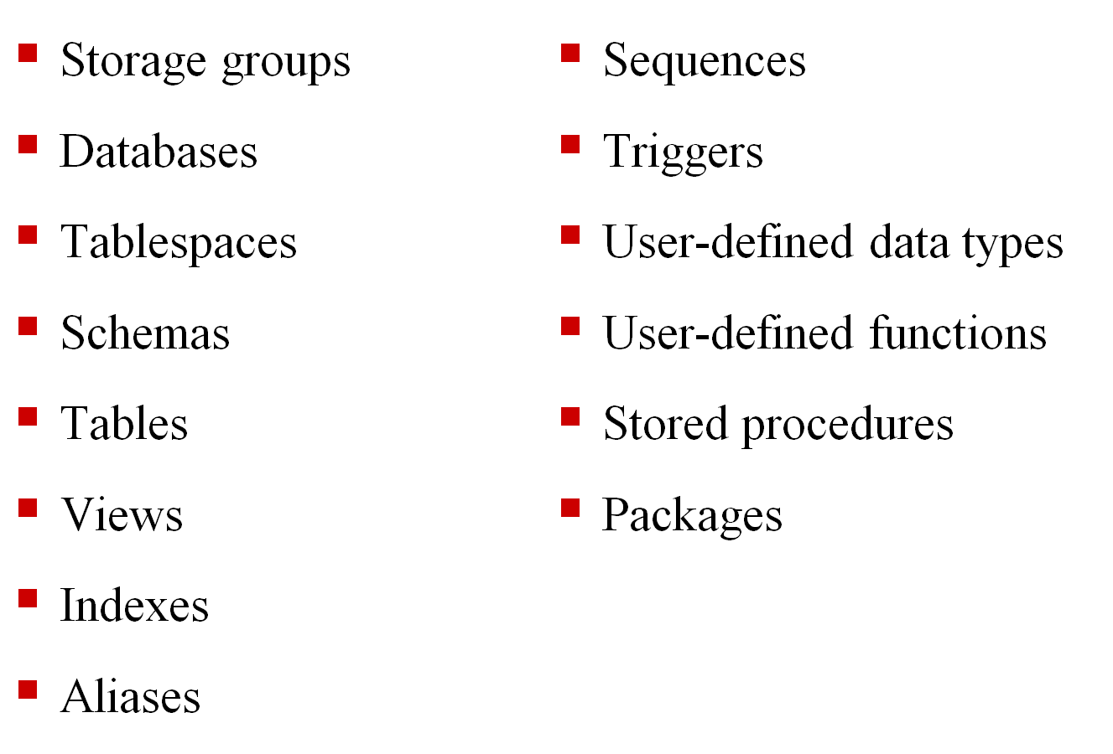
DB2 Data Objects

Slide 8
DB2 Data Objects
Storage Group It is a collection of direct access volumes, all of the same device type
Database A collection of logically related objects like table spaces, index spaces, tables etc. a storage group and buffer pool must be defined for each database
Table Space Logical address space on the secondary storage to hold one or more tables. It is the storage unit for recovery and reorganizing purpose Three types
    Simple
    Segmented
    Partitioned

Slide 9
DB2 Data Objects
  Simple Table Spaces can contain more than one stored tables i.e. A single page can contain rows from all the tables
  Storing more than one tables might enable faster retrieval for joins using the tables but creates locking problem
Segmented Table Space contain more than one stored tables, but in a segmented space. a segment consists of a logically contiguous set of pages and no page is allowed to contain records from more than one table.
  Sequential access to a particular table is more efficient. Lock table, lock the table but not the entire table space
Partitioned Table Space primarily used for very large tables. Only one table in a partitioned table space

Slide 10
DB2 Data Objects
Schemas are objects that are used to logically classify and group other objects in the database.
  Four schemas that are automatically created when a database is created-SYSIBM, SYSCAT, SYSSTAT, and SYSFUN. The default schema, which is usually the user ID of the individual who created the object.
A Table is a collection of rows and columns ,Tables present data as a collection of unordered rows with a fixed number of columns;
  Each column contains values of the same data type or one of its subtypes, and each row contains a set of values for each column available.

Slide 11
DB2 Data Objects
Views are used to provide a different way of looking at the data stored in one or more base tables.
  Although views look similar to base tables, they do not contain real data. Instead, views refer to data stored in other base tables.
An Index is an object that contains an ordered set of pointers that refer to rows in a base table. Each index is based upon one or more columns in the base table it refers to (known as keys).
  They provide a fast, efficient method for locating specific rows, It is important to keep in mind that when the UNIQUE clause is used, it is possible to have an index key that contains one (and only one) NULL value.

Slide 12
DB2 Data Objects
An Alias/Synonym is simply an alternate name/nicknames for a table or view. Once created, they can be referenced the same way the table or view.
Difference between Alias and Synonym
Synonym is private object only the user who created can access it and SYSADM authority is not needed where as Alias is a global object, accessible by anyone, required sized authority or privilege
Used in local environment to hide high level qualifier, alias is distributed environment
When base table is dropped synonyms are dropped where alias are not

Slide 13
Thank You

